Slide 1


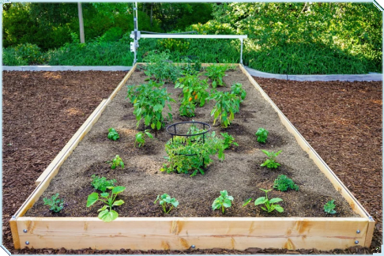
COMP 90082
Software Project
FarmBot
Team BoxJelly
Dikai ZHU, Chengtian JIANG, Yuxi HE,
Tingzheng REN, Zhiyu CHEN

Slide 2

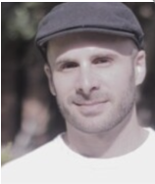
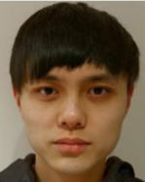
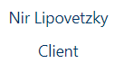
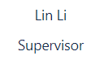
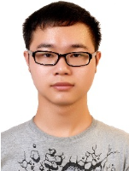

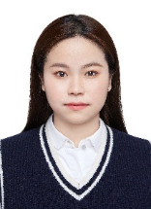
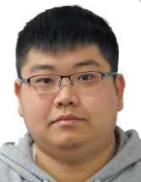
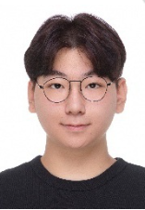
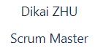
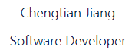
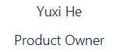
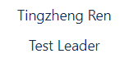
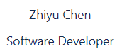
Project members

Slide 3
Background
Project Goals
Technologies
Project Demo
Future development
CONTENTS

Slide 4
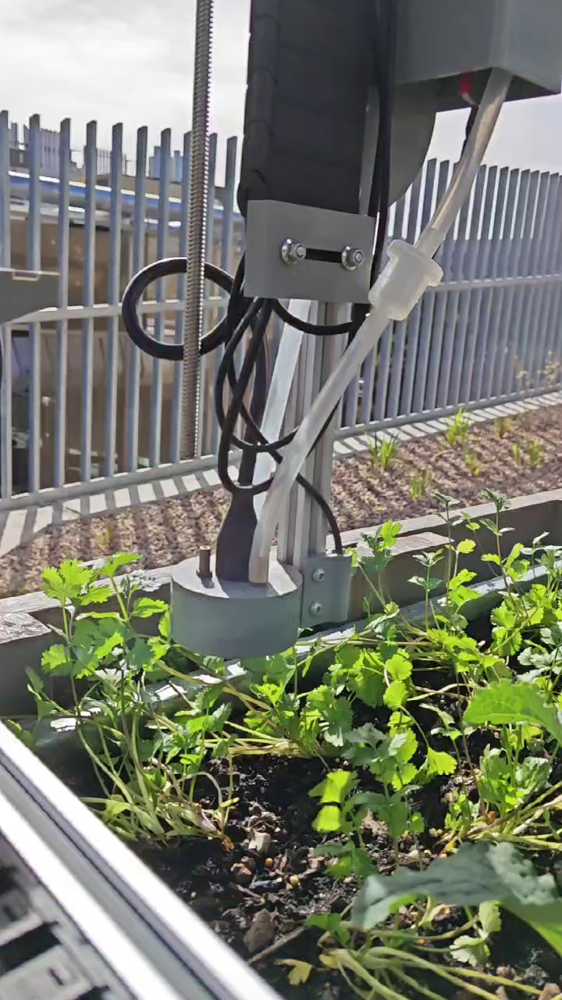
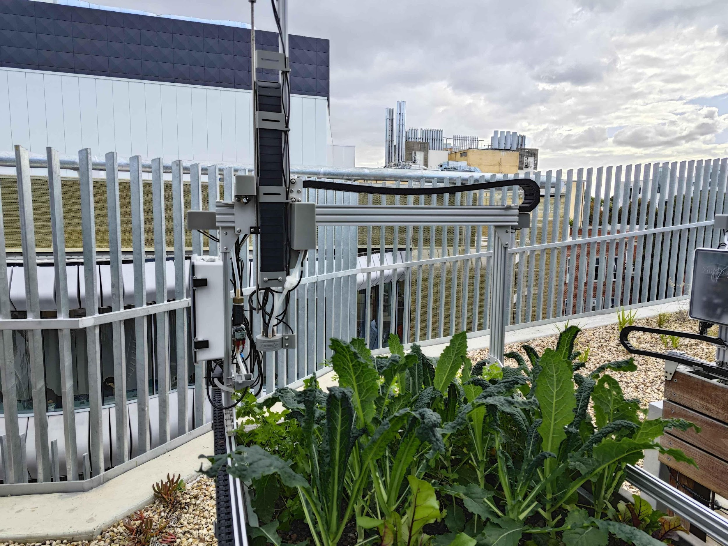
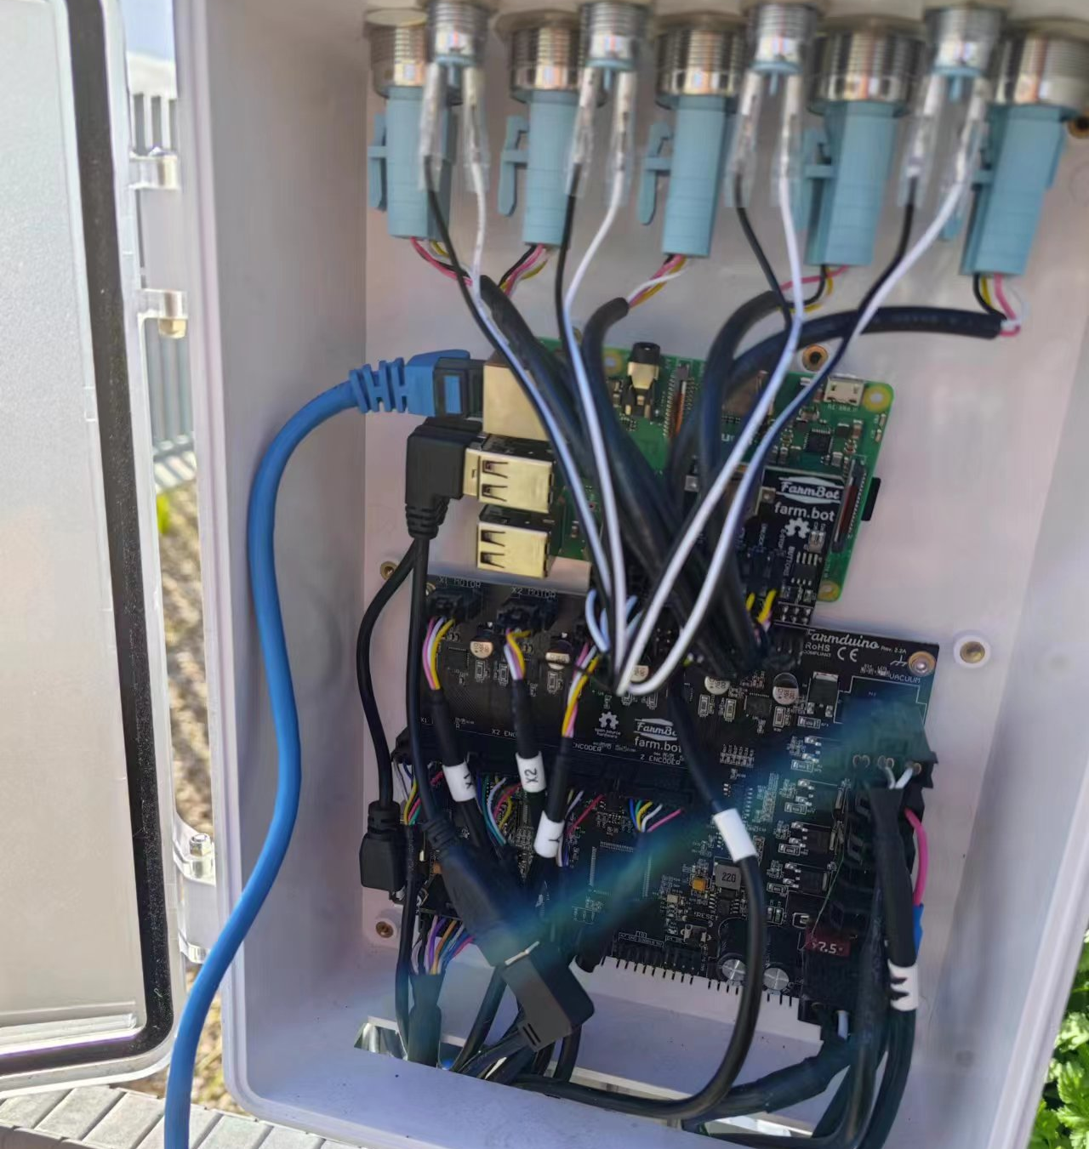
Background
What is Farmbot Project?
A robot make farming easier!
Automatically plant caring and data collecting

Slide 5
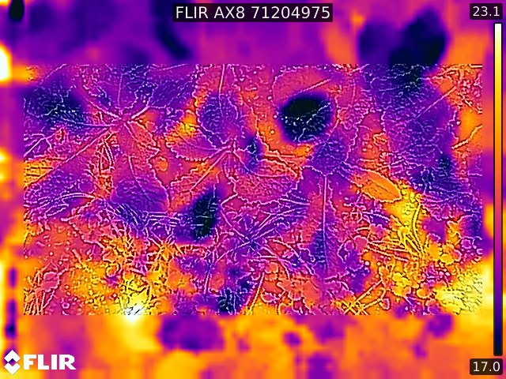
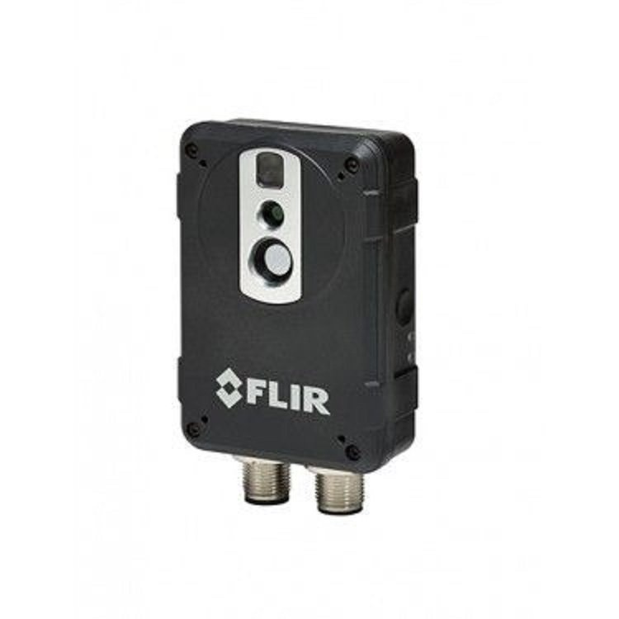
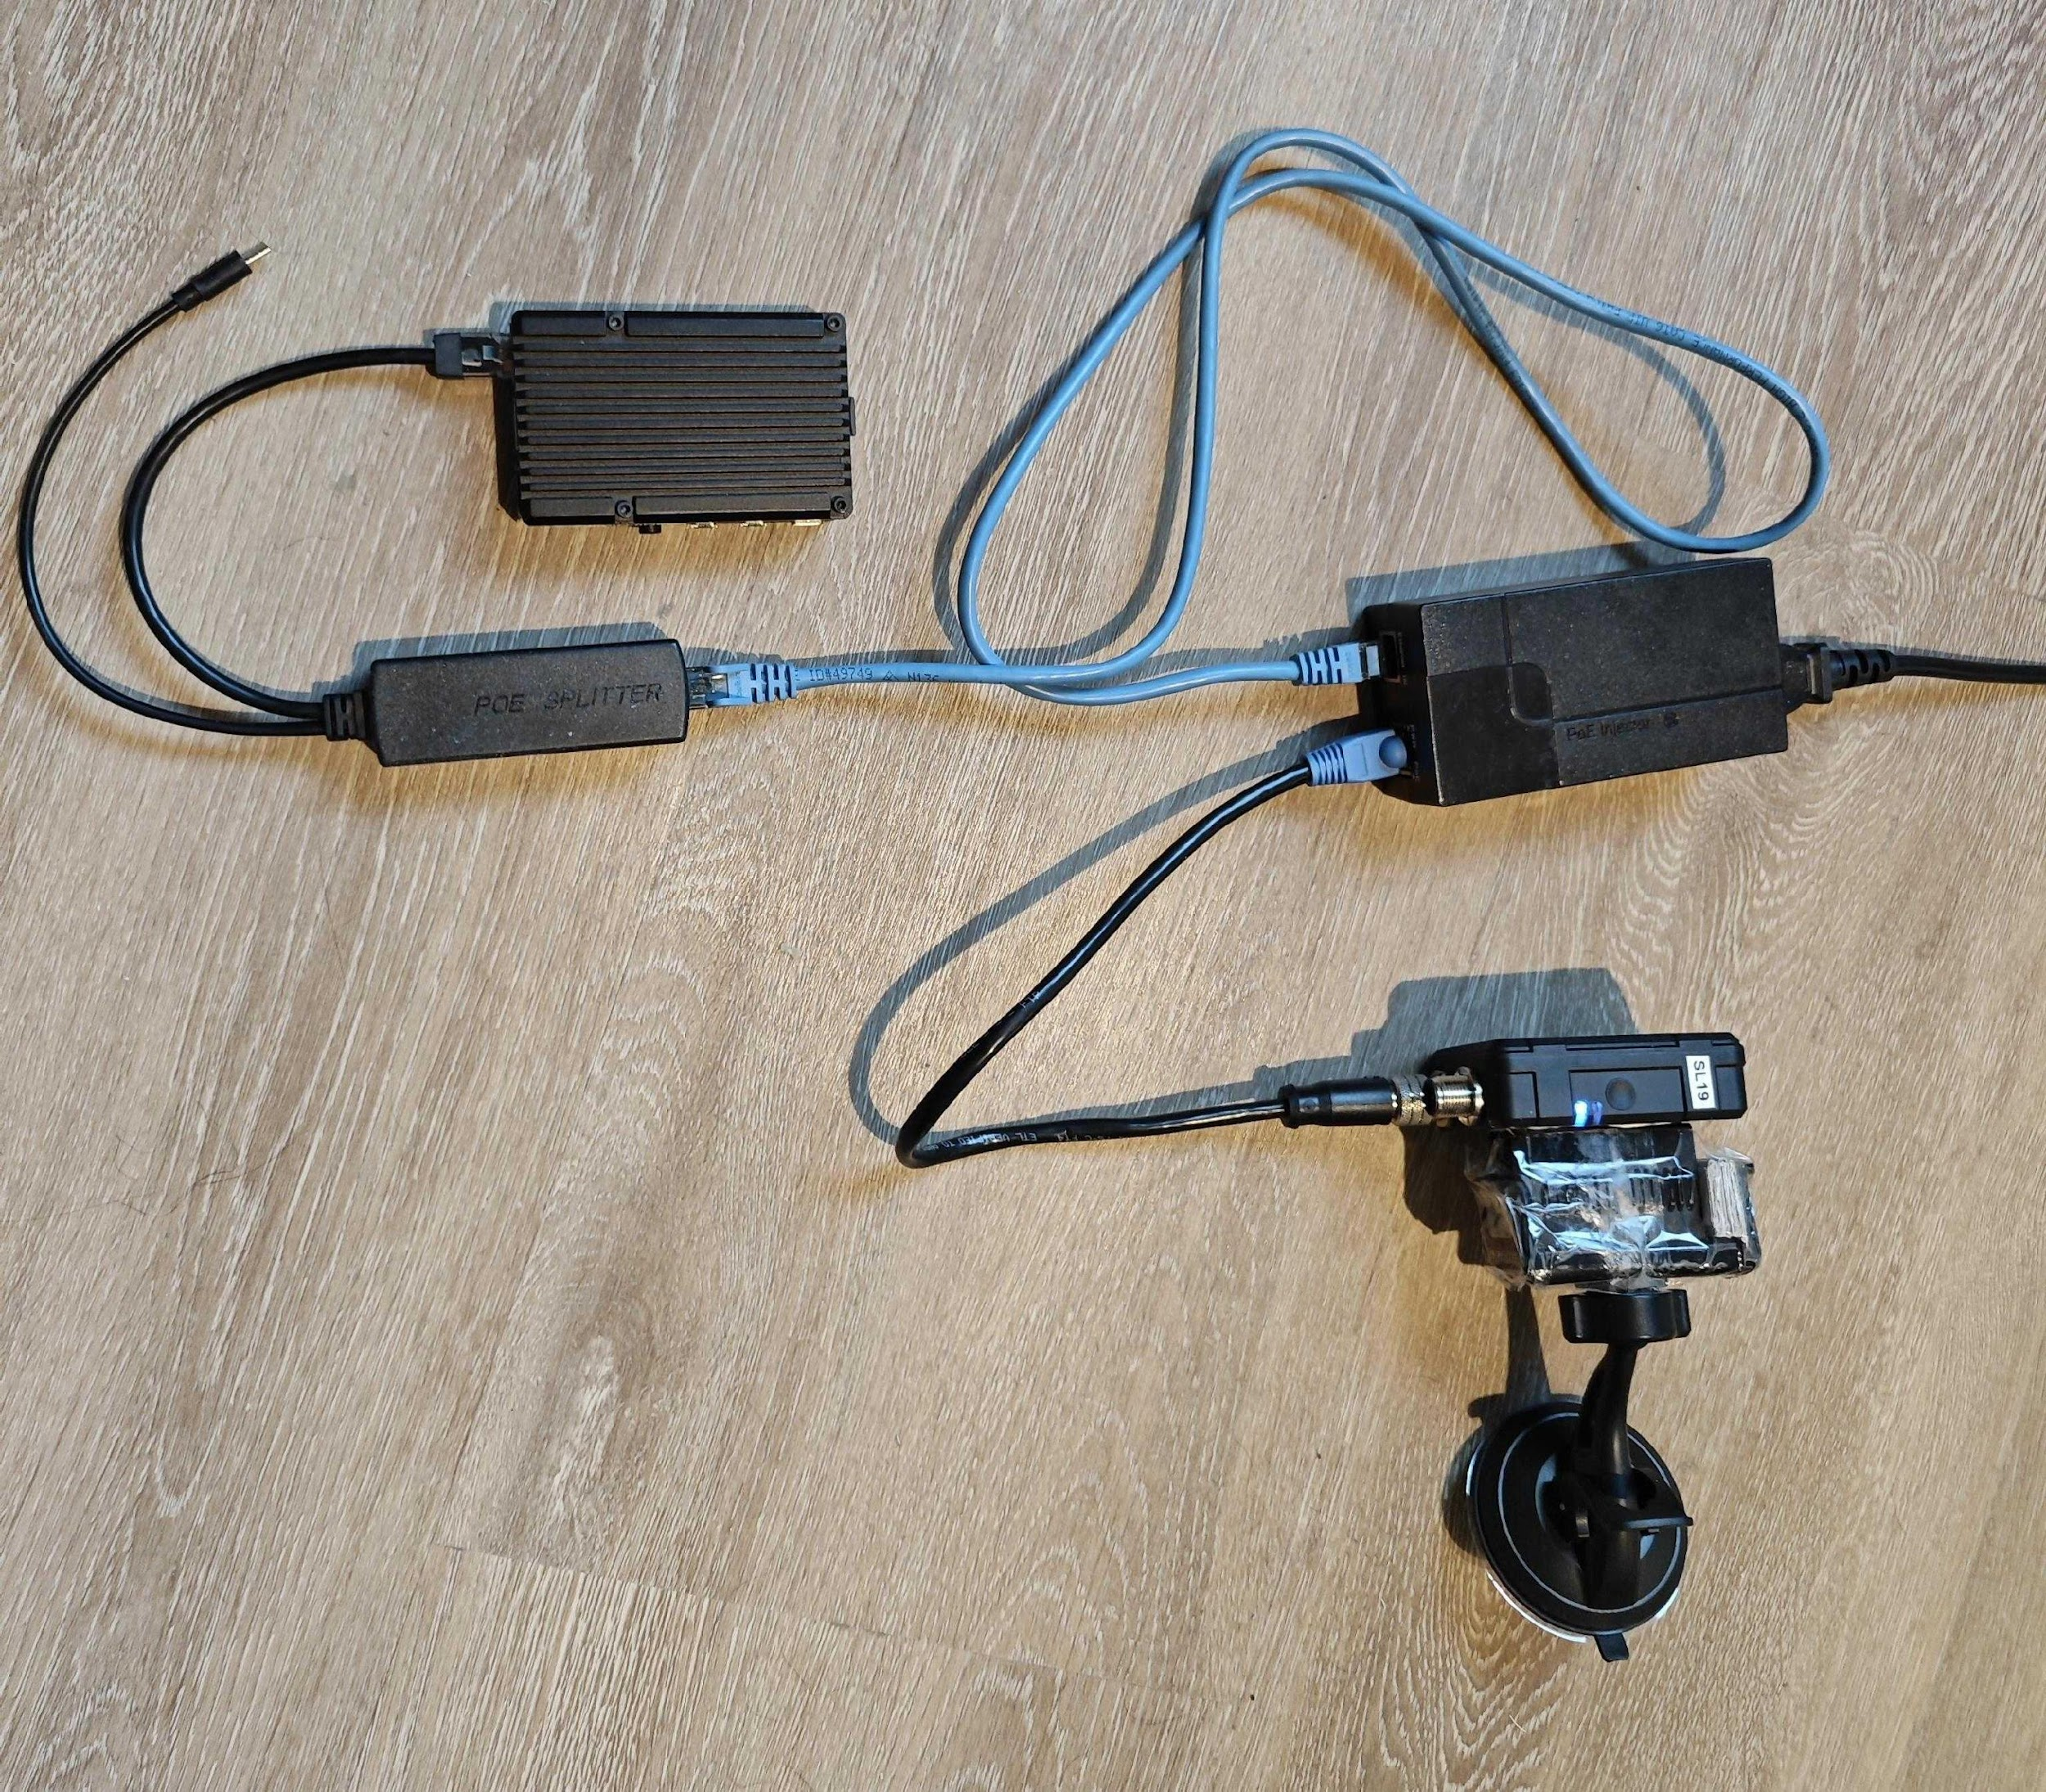
Project Goals
Integration of a Thermal Camera (self-established Ethernet connection)
why
Temperature monitoring
Disease and pest diagnosis
Irrigation optimization
Thermal energy utilization
Data analysis and decision support
Power of Thermal Cameras
Plant health monitoring
Irrigation optimization
precision farming
Crop maturity assessment
Environmental monitoring

Slide 6
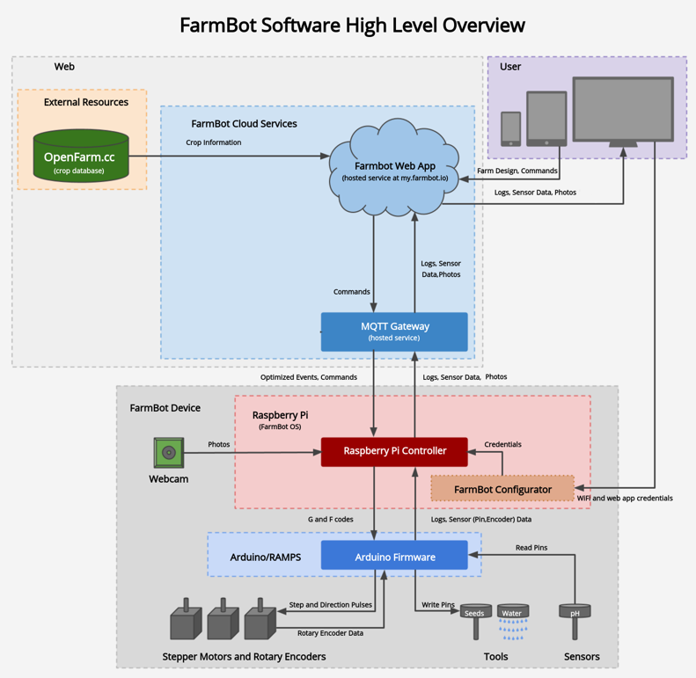
Technologies
What composed the Farmbot Project?
Farmbot arm Raspberry Pi and Farmduino
Front-end: typescript
Database: postgresql
Back-end: flask
OS: erlang, nerves and elixir

Slide 7
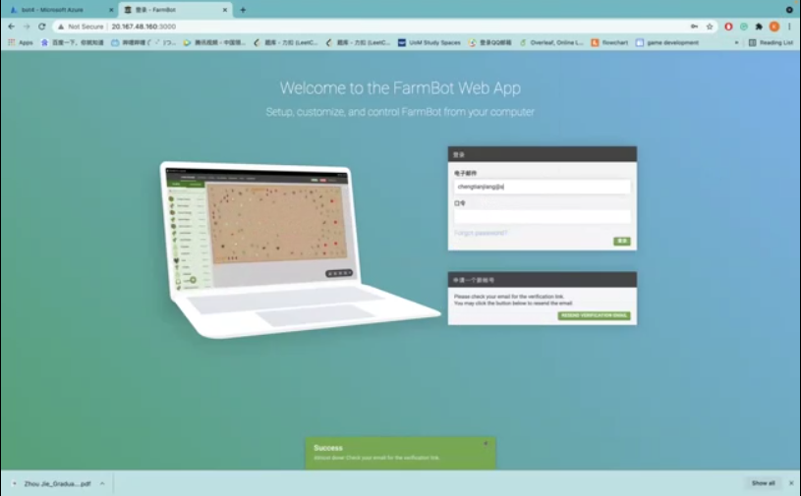
Project Demo: Deployment
Web-APP
Farmbot OS
Thermal Camera

Slide 8
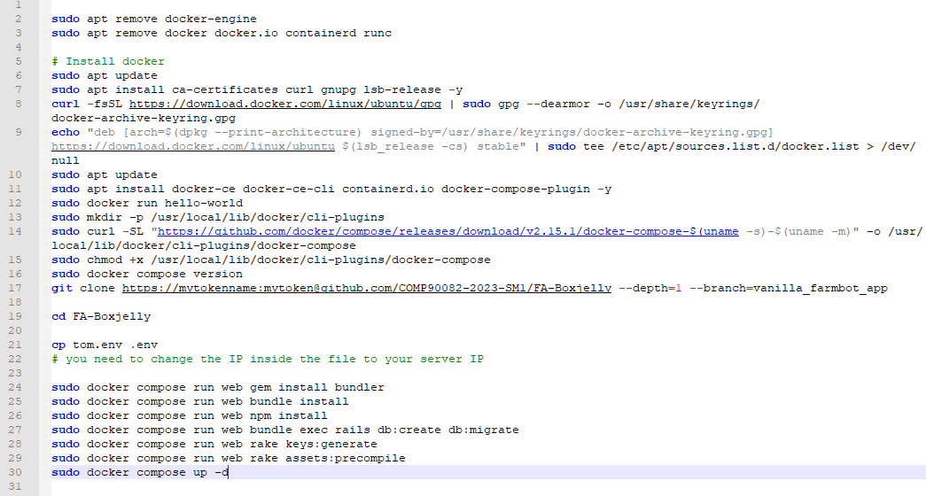
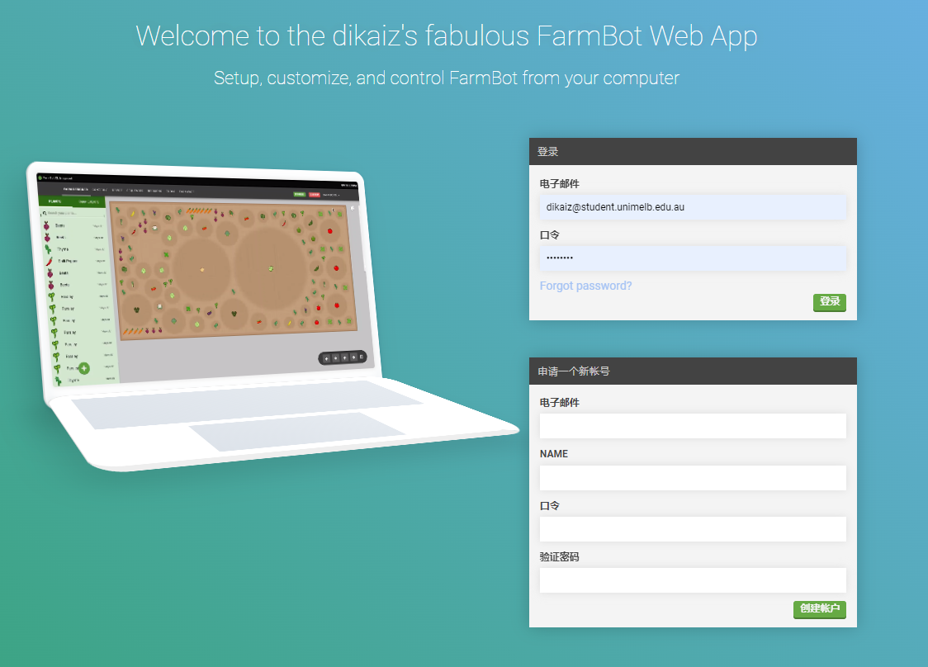
Project Demo: Deployment
Web-APP
Farmbot OS
Thermal Camera

Slide 9
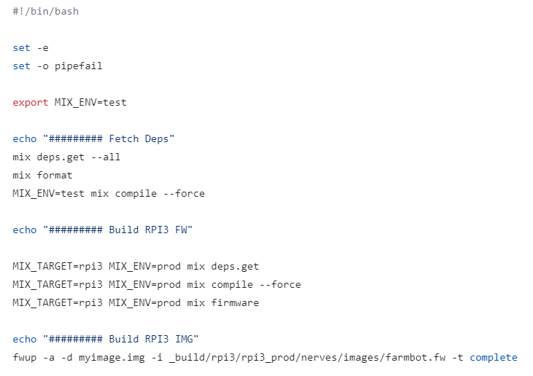
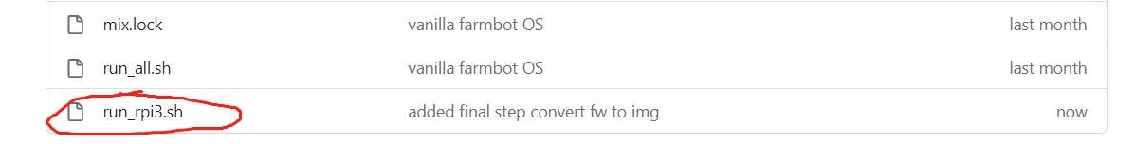
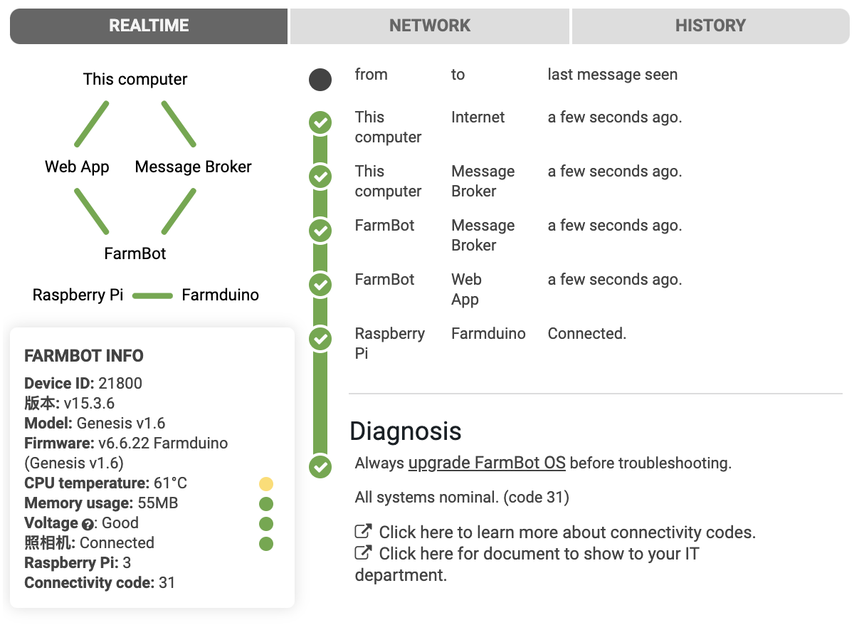
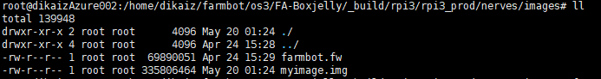
Project Demo: Deployment
Web-APP
Farmbot OS
Thermal Camera

Slide 10
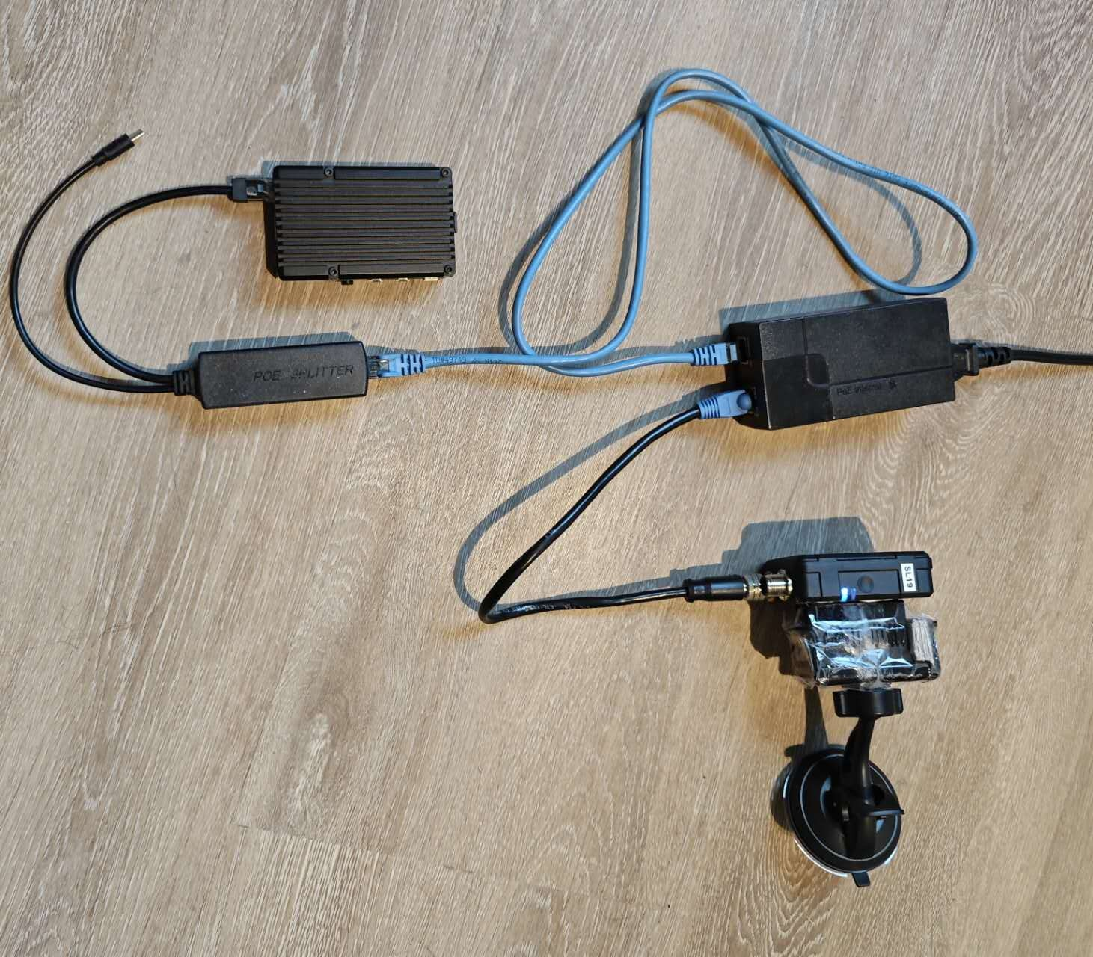
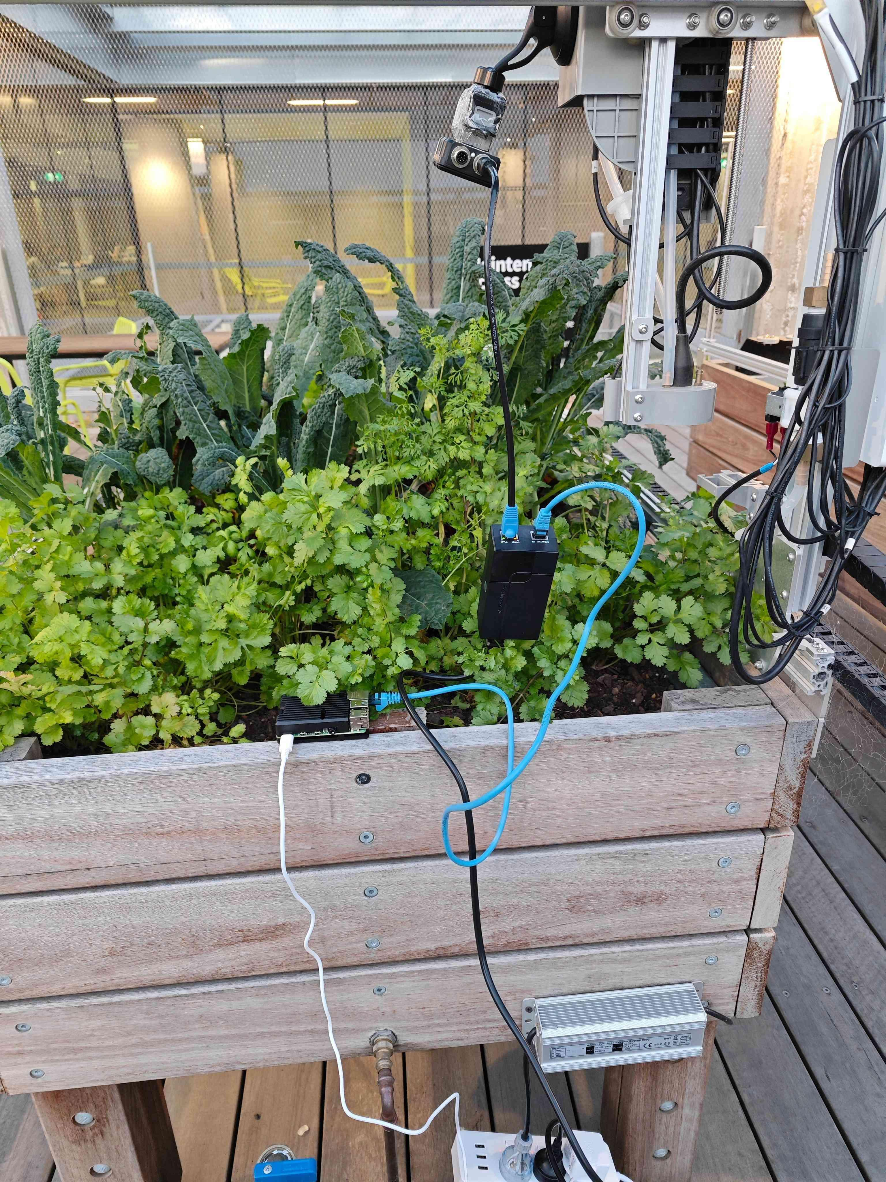
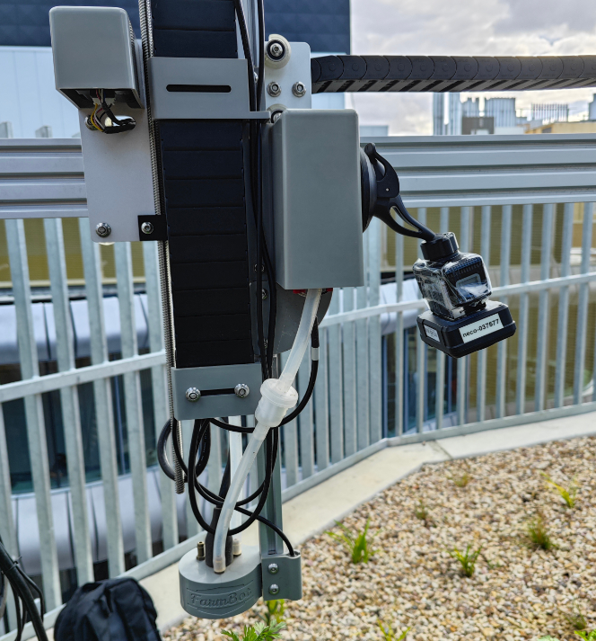
Project Demo: Deployment
Web-APP
Farmbot OS
Thermal Camera

Slide 11
Project Demo: Information Flow
1. click button on front end
2. request created
3. message broker dispatch request
4. OS receives request
5. OS create a node on AST
6. AST execute to the node
7. Action taken

Slide 12
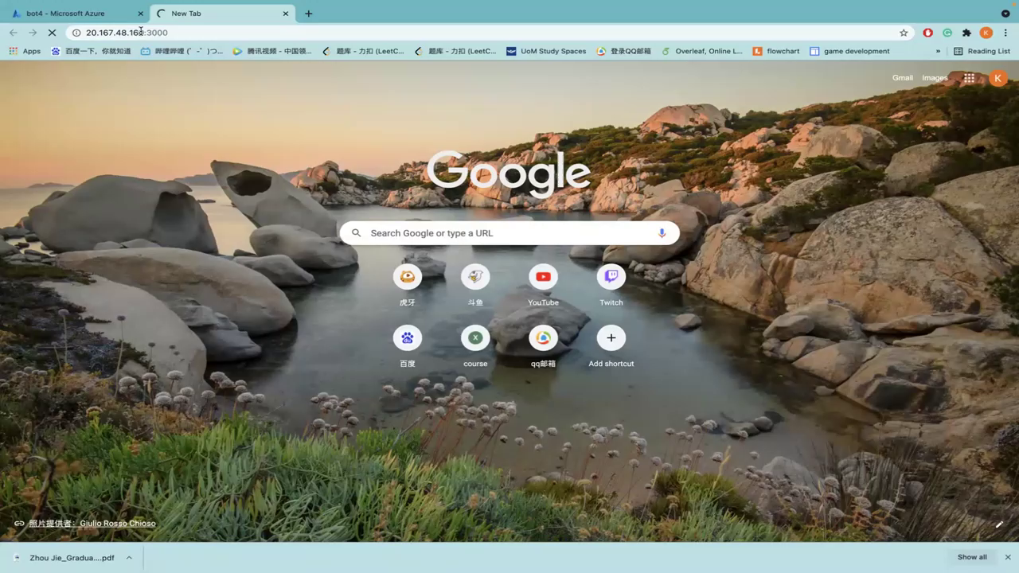
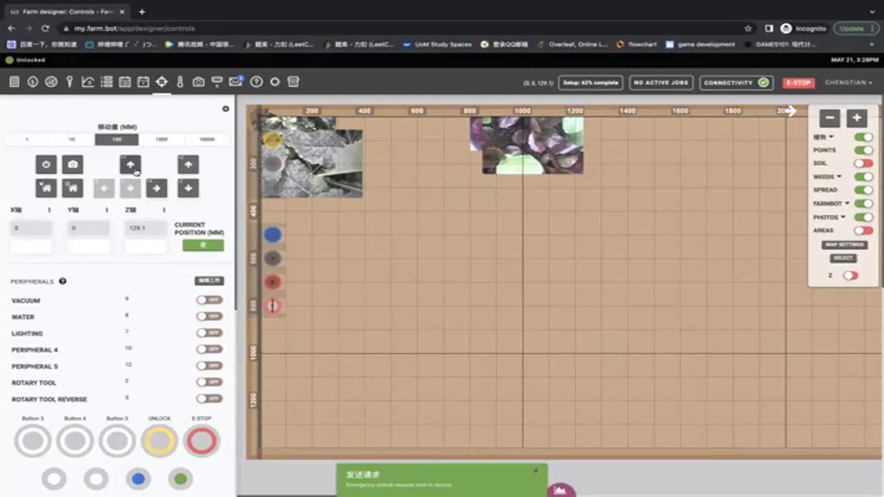
Project Demo

Slide 13
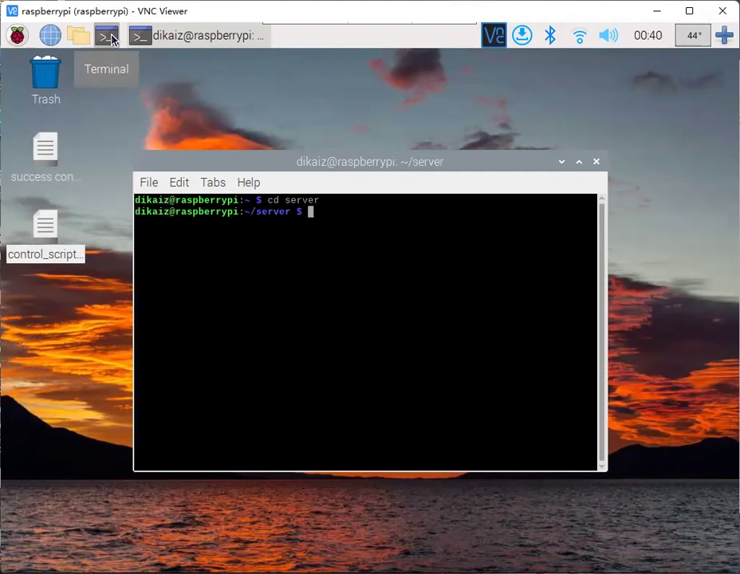
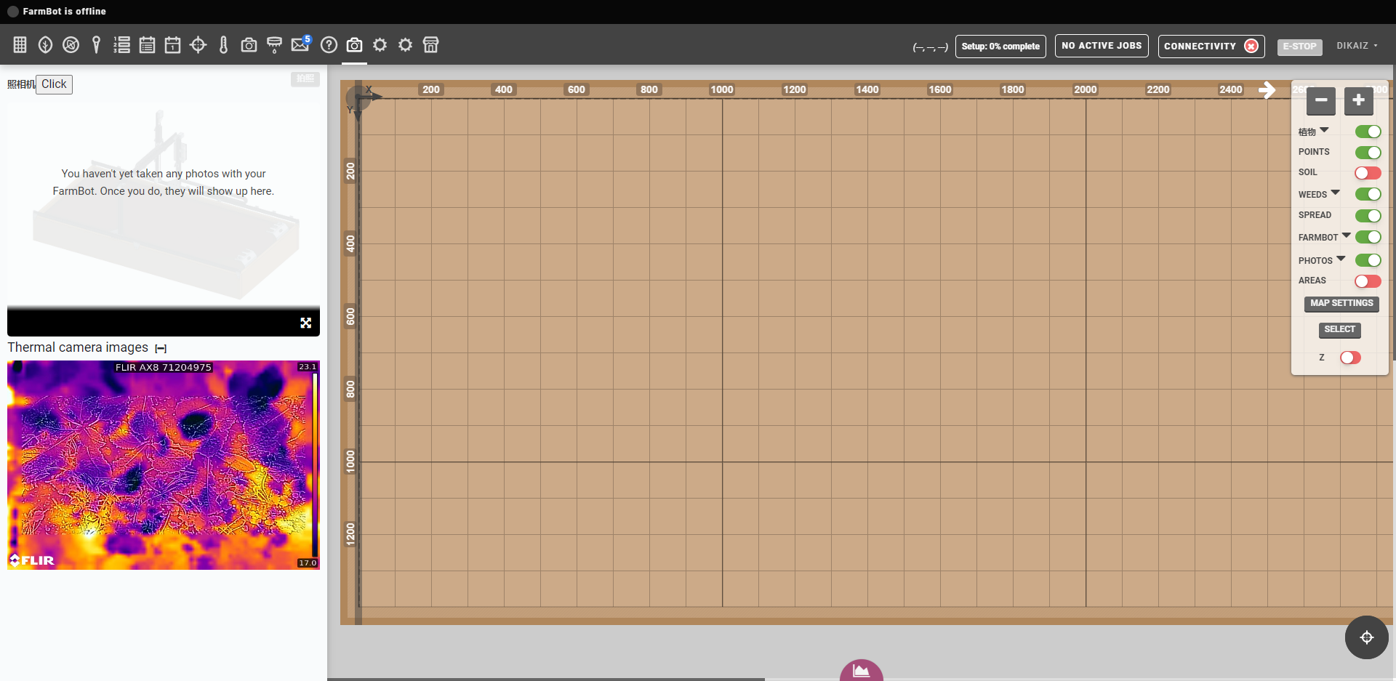
Project Demo

Slide 14
Challenges
1. Source code is very poorly documented and very complex.
2. Thermal Camera provides no User API
3. Many elements in the original web app is hard coded.
4. Farmbot OS provide no SSH nor HDMI.

Slide 15
Future Development
1. Finish Integration (embed scripts into OS)
2. Auto convert thermal pictures into thermal data
3. Automatically analysis process with thermal data we got

Slide 16
THANK YOU！
Questions？

